Slide 1
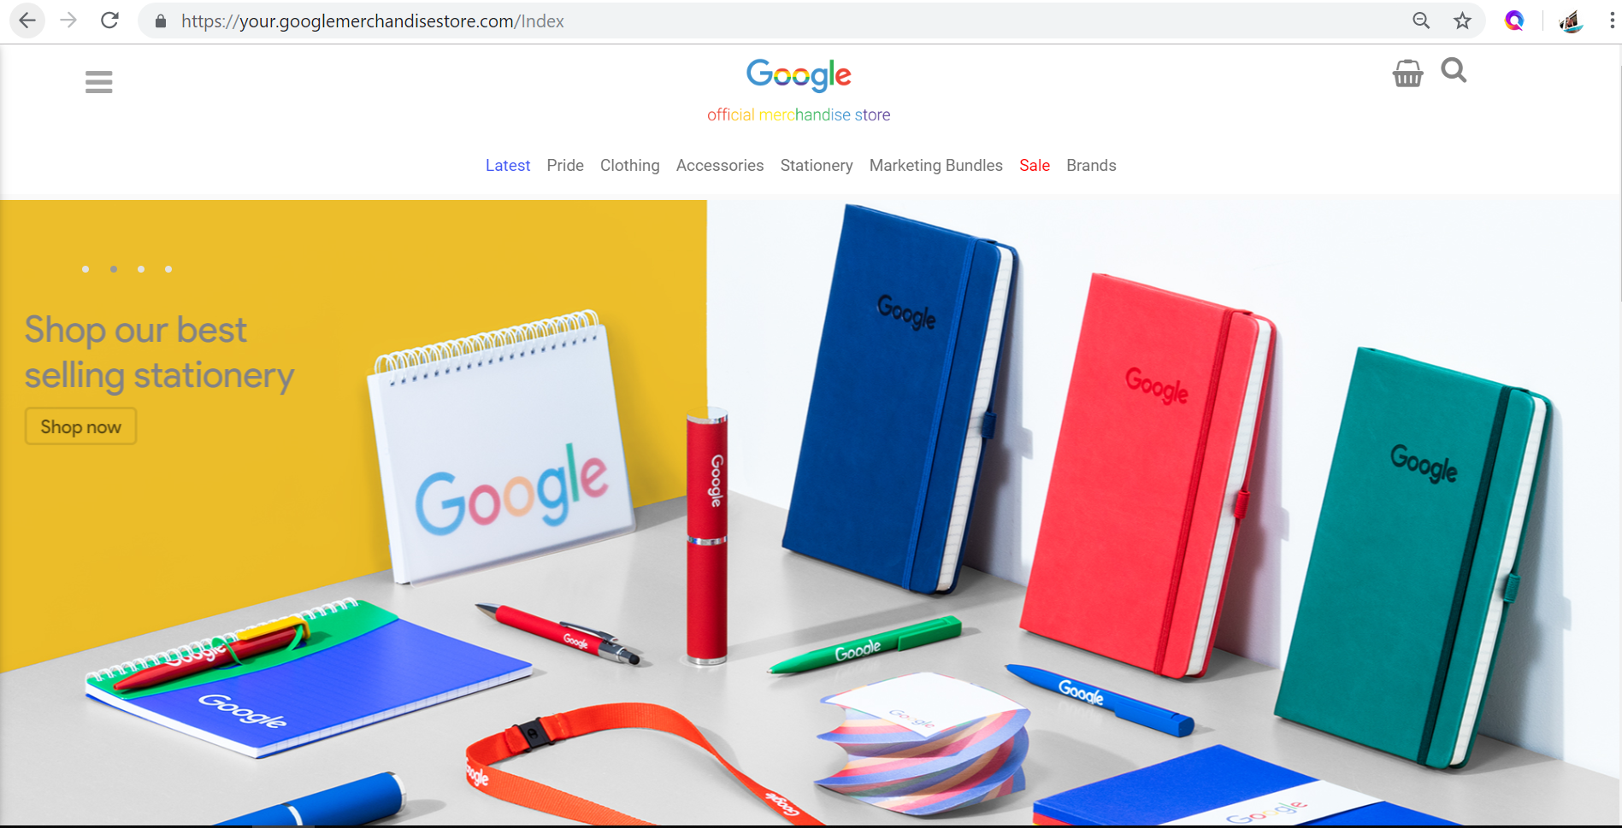

Predicting Conversion from Google Merchandise Store
Group 5 –
Desmond Ho, Evelyn Lim,
Jiang Nan, Lee Meng Yong

Slide 2
Agenda
1 Introduction
2 Feature Engineering
3 Model Performances
4 Model Evaluation

Slide 3
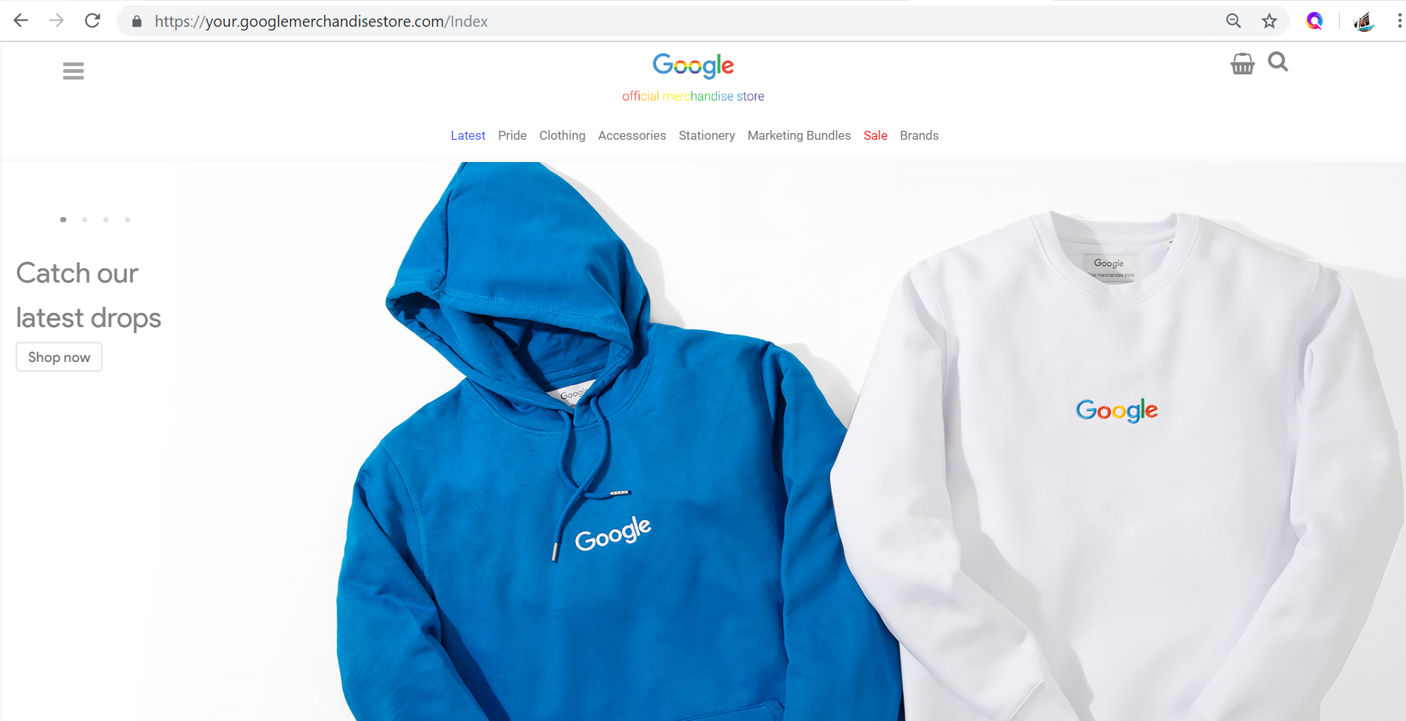
About Google Merchandise Store
E-commerce
Where you can get your Google Swags
Apparel
Bags
Accessories
Drinkware
Notebook, stickers, etc.
Two websites
US
International

Slide 4
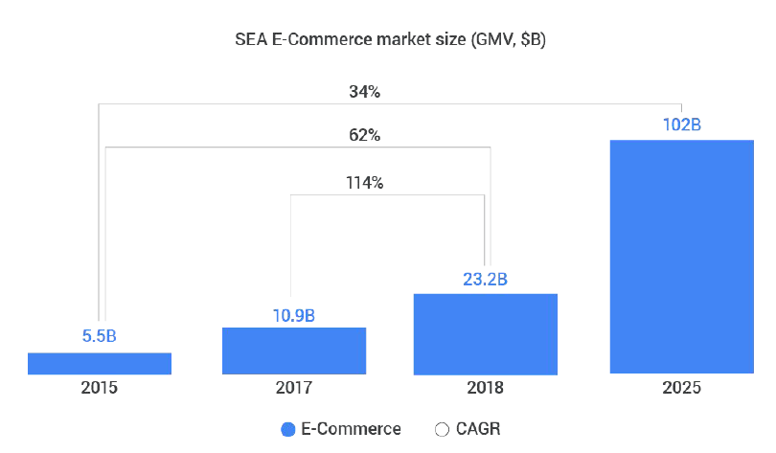
Motivation: Booming E-commerce Market
GMV: Gross Merchandise Value; CAGR: Compounded Annual Growth Rate.
https://www.thinkwithgoogle.com/intl/en-apac/tools-resources/research-studies/e-conomy-sea-2018-southeast-asias-internet-economy-hits-inflection-point/

Slide 5
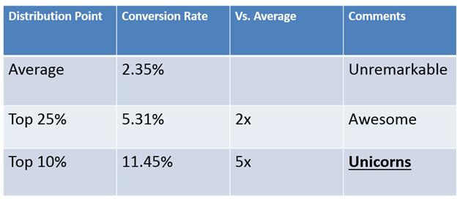
Motivation: Conversion Rate vs High Revenues
Average Ecommerce Conversion 2.86%
Conversion Revenue
https://www.invespcro.com/blog/the-average-website-conversion-rate-by-industry/

Slide 6



Machine Learning Problem
Experience
Customers’ click stream data from Google Merchandise Store
Task
Predict Conversion in the next 7 days
Performance Measure
F2 score, prioritizing Recall over Precision
Clickstream Data
Likelihood of Purchase in the next 7 days
Performance Measure

Slide 7
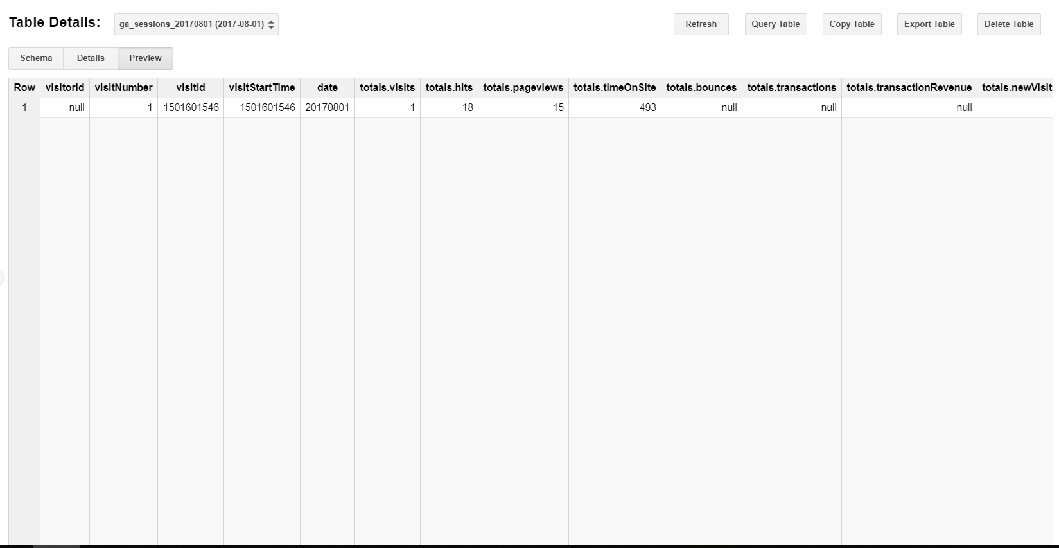
Dataset Source: Google Bigquery Public Data
Extremely large and rich dataset
Data at the granularity of sessions, hits, and product level
338 Variables
Time-partition
Nested fields

Slide 8

Getting into the mind of consumers
???
Feature Engineering:
What would make people buy?

Slide 9
Refining the Analytical Question
Analytics Question 1: Predicting conversion in time period A using data from time period B
Data
Target
Analytics Question 2: Predicting conversion from time period A using data from time period A
Data
Target
Analytics Question 3: Predicting future conversion from customers using customers’ past data
Visitor A
Visitor B
Visitor C
Visitor D

Slide 10
Dataset Architecture:
Short term vs Long Term Behavior
Target:
If the visitor purchase in the next 7 days
Today (20 Variables)
Visitor’s activity today
Total hits, sessions, time on site, channel grouping, country, device, metro, city, operating system, source
Short Term Behavior (7 Variables)
Visitor’s activity in the 7 days prior
Total visits, hits, sessions, time on site, etc.
Long Term Behavior (7 Variables)
Visitor’s activity in the 90 days prior
Total visits, hits, sessions, time on site, etc.

Slide 11
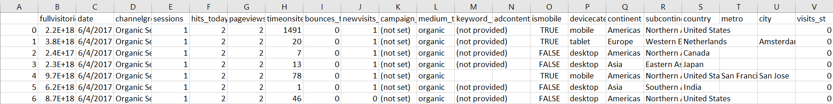
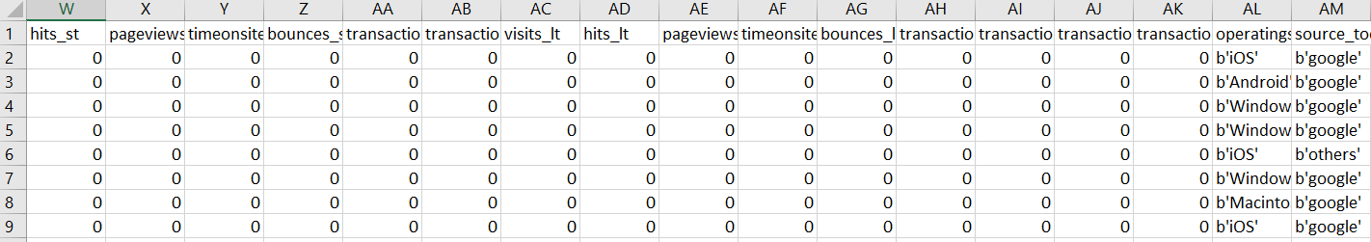
Dataset: Sample
Identifier
Activities today
Activities from last 7 days
Activities in the 90 days prior
Target
Dataset
1 target variable, 20 variables from today, 7 from short term, 7 from long term
Training date range – 1 March 2017 to 30 May 2017
Test date range – 1 June 2017 to 30 June 2017

Slide 12
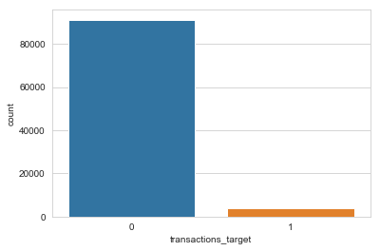
Exploratory Data Analysis
Positives Rate 3.9 %
Relatively imbalanced dataset
Johnny + everything above
126

Slide 13
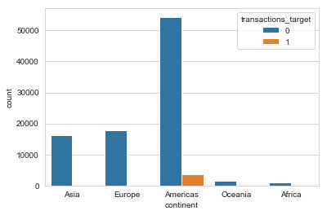
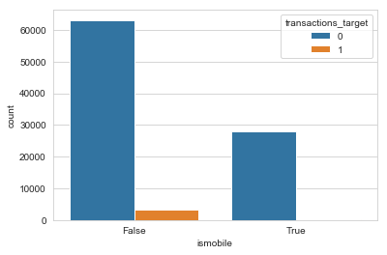
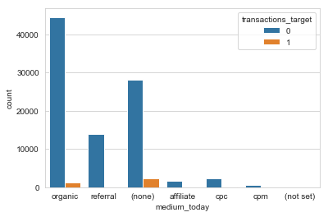
Exploratory Data Analysis
Most transactions originate from America.
Most transactions are from desktop.
Organic medium has higher conversion.
Notes:
Positives = 3.9 %
Continent - Most transactions originate from America
ismobile - Most transactions are from desktop
Medium - Organic and (none) have higher conversion

Slide 14



Methodology and Evaluation
Feature Engineering
Classification Model
Interpretation
Exploratory Data Analysis
Topic Modeling
Feature Scaling
Undersampling
Logistic Regression
Random Forest
Adaboost
Light Gradient Boosting
Neural Network
Anomaly Detection
Feature Importance
Error Analysis
‹#›

Slide 15
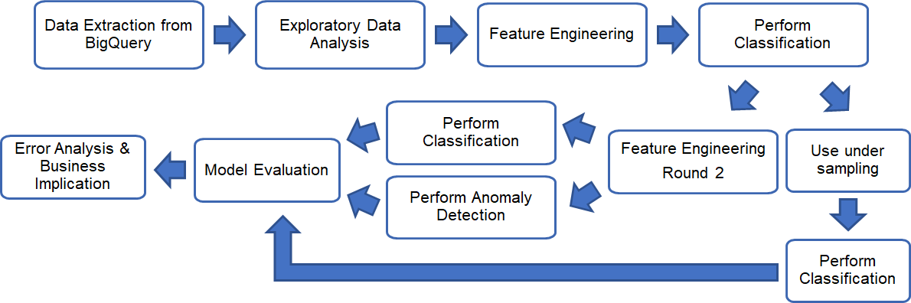
Flow Chart
Flow Chart using the new dataset which has both short term and long term user attributes

Slide 16
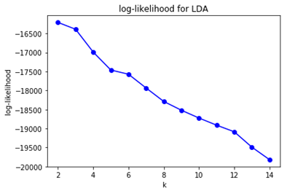
Feature Engineering
Round 1
Reduce dimensionality on categorical variables with many categories
Convert Date from dd/mm/yy to mm/yy
Regrouped Operating System
Regrouped Source
Round 2
Topic Modeling on ‘Keyword’
Perform Latent Dirichlet Allocation (LDA)
select cluster, k=5

Slide 17
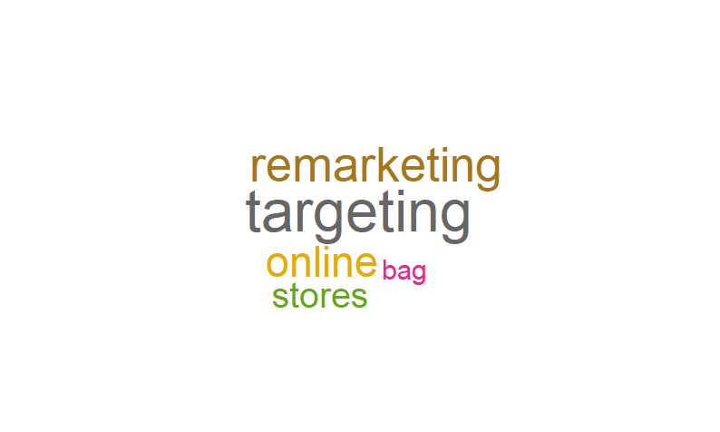
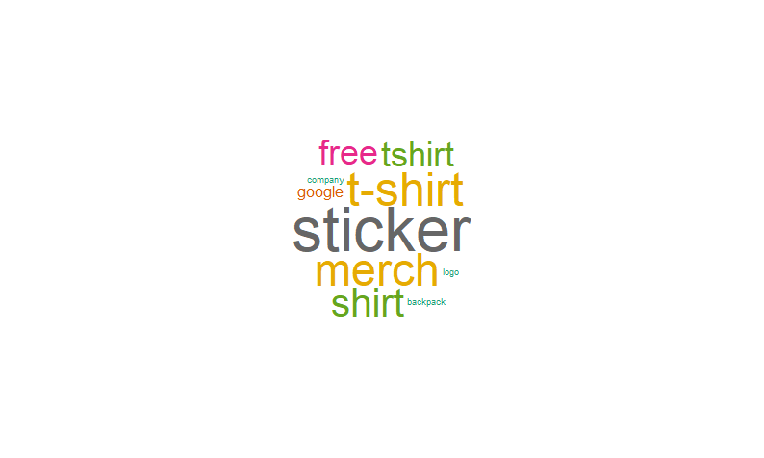
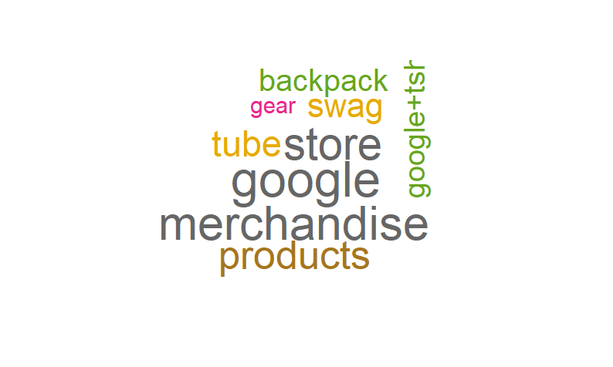
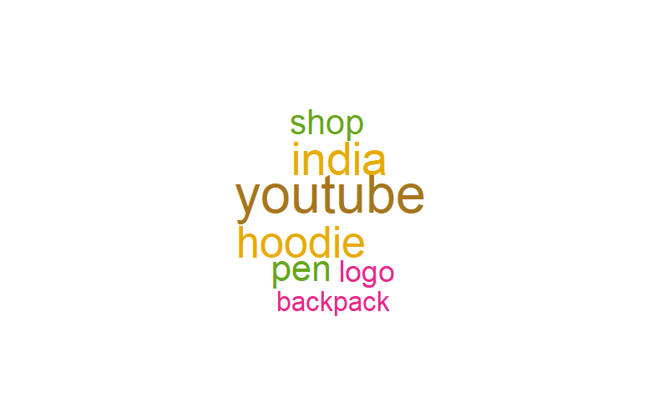
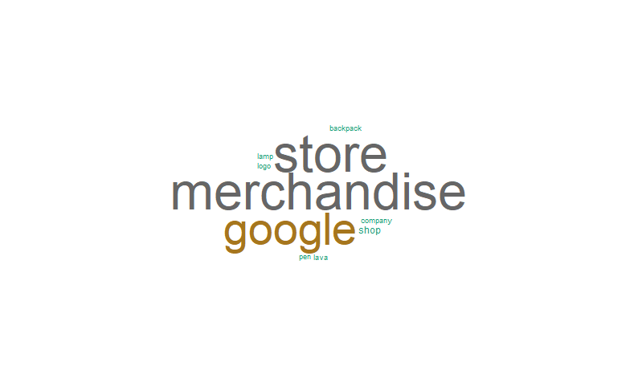
Topic Clusters

Slide 18
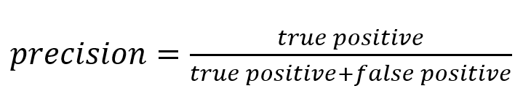
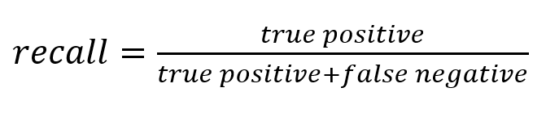
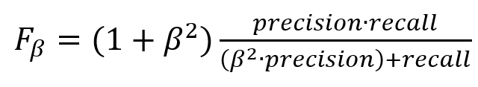
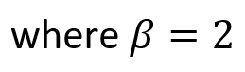
Performance Metrics (F2-score)
Assuming marketing cost such as edm is relatively low, classification models are optimised and selected based on F2-score
F2-score gives a higher weightage to recall measure

Slide 19


Classification Results (F2-score)
Models | Data without Feature Engineering Rd 2 | Data without Feature Engineering Rd 2 with under sampling | Data with Feature Engineering Rd 2
Logistic Regression | 0.492 | 0.425 | 0.491
Random Forest | 0.612 | 0.521 | 0.600
Adaptive Boosting | 0.609 | 0.534 | 0.511
Light Gradient Boosting | 0.406 | 0.543 | 0.417
Multi-layer Perceptron | 0.400 | 0.466 | 0.467
Better Recall
Better Precision

Slide 20
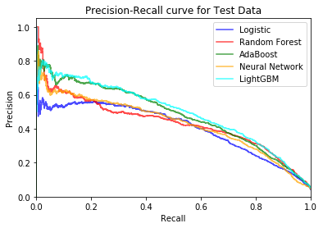
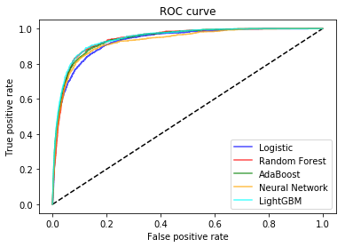
Classification Results
AdaBoost and Light Gradient Boosting perform better in terms of precision

Slide 21
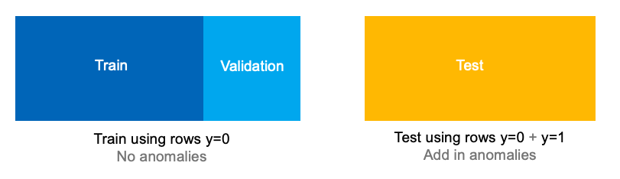
Anomaly Detection
High class balance (minority 3.9%) - Are they anomalies?
Ran 2 models:
oneClassSVM - Outlier Detector. Unsupervised Learning which estimates the support of a high-dimensional distribution.
IsolationForest - Novelty Detector. ‘Isolates’ observations by randomly selecting a feature and then randomly selecting a split value between the maximum and minimum values of the selected feature.
Dataset:

Slide 22
Results were not as good as the other models
Could not extract feature importance.
Models without LDA
Measure | OneClassSVM | Isolated Forest
Recall | 0.702 | 0.050
Precision | 0.035 | 0.020
Accuracy | 0.240 | 0.875
F1 | 0.060 | 0.030
F2 | 0.140 | 0.040
Models with LDA
Measure | OneClassSVM | Isolated Forest
Recall | 0.706 | 0.030
Precision | 0.036 | 0.020
Accuracy | 0.236 | 0.904
F1 | 0.068 | 0.024
F2 | 0.149 | 0.027

Slide 23
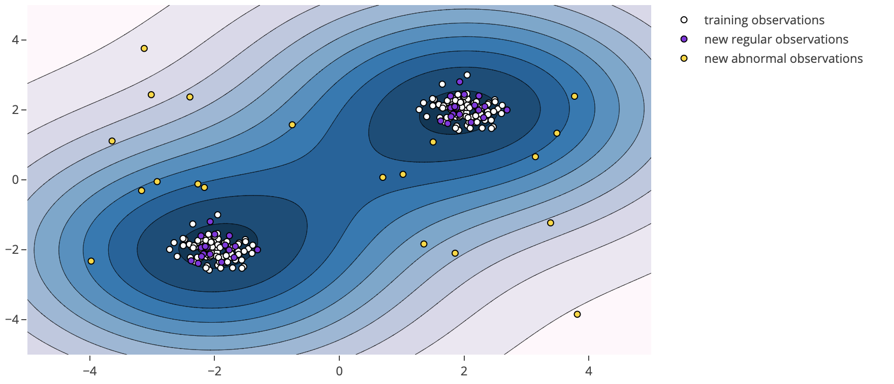
Anomaly Detection
What anomalies look like:

Slide 24
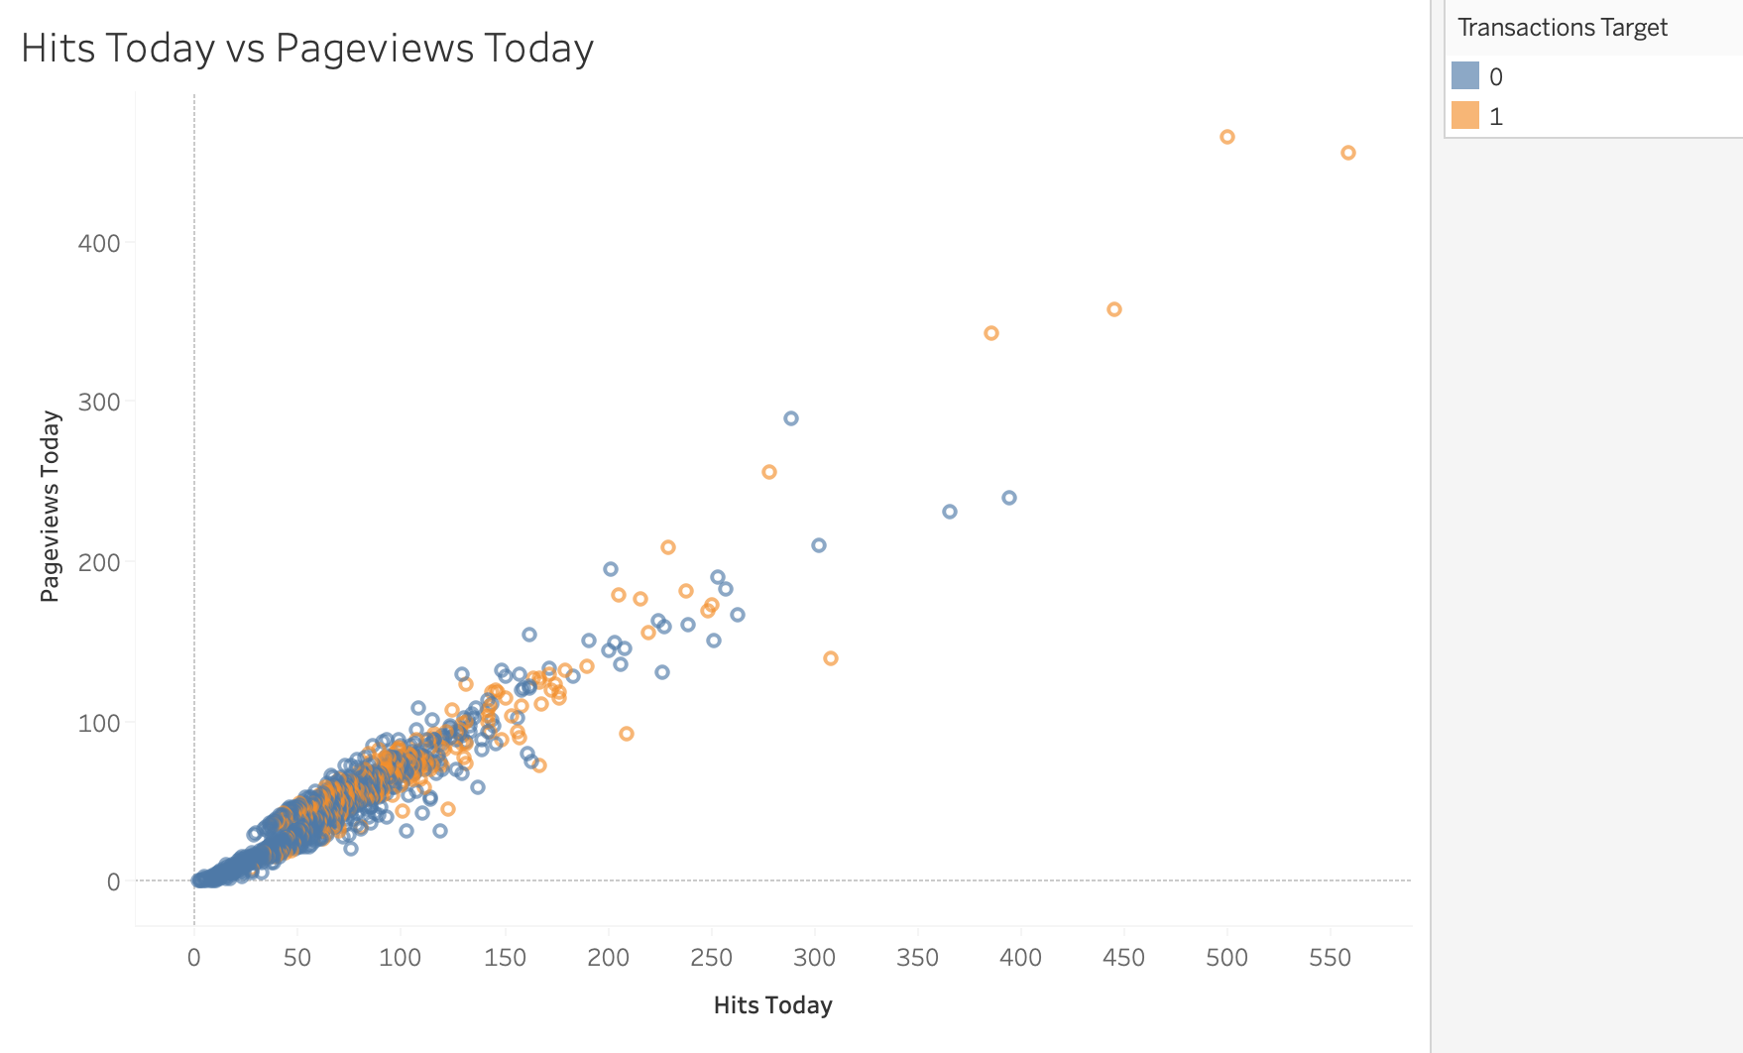
Anomaly Detection
Our dataset looks like this:

Slide 25
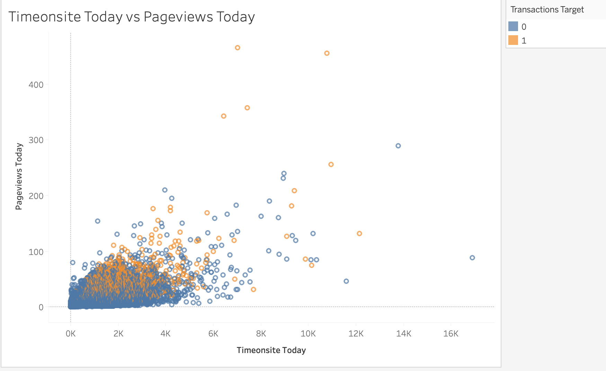
Anomaly Detection
Our dataset looks like this:

Slide 26
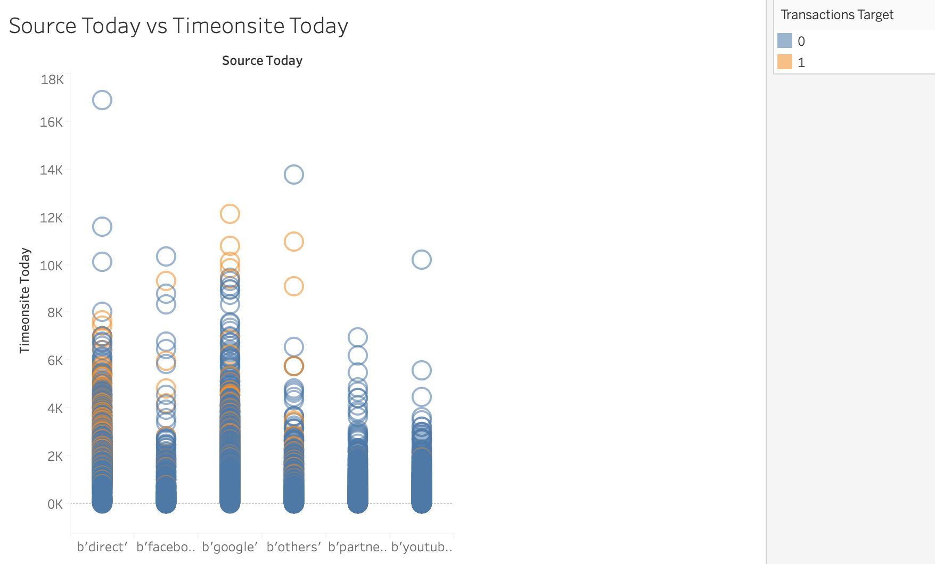
Anomaly Detection
Our dataset looks like this:

Slide 27
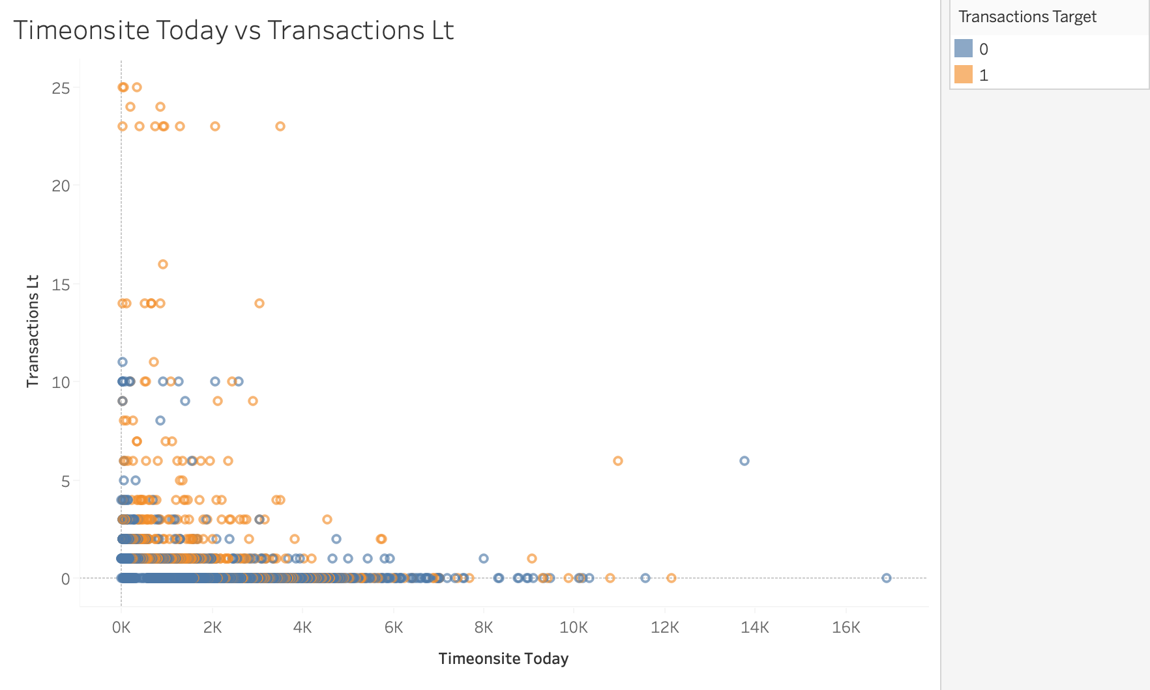
Anomaly Detection
Our dataset looks like this:

Slide 28
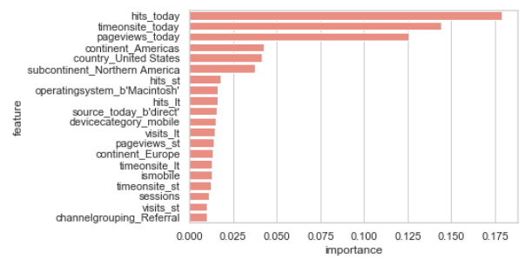
Understanding the winning model
Feature Importance
Visitors with High hits/timeonsite/pageviews
Visitors living in America
Repeat Visitors
Mac & Desktop users
Source = Direct
Notes:
And now that we have our winning model, we need to understand what we can do with the model, and understand how the business can use this model
From the feature importance chart, we can have a rough sense of how the model works. We can see that visitors with a high hits, time on site, and pageview are most likely to purchase. In terms of geography Visitors living in America tend to have a higher probability of purchase, and in terms of device, visitors using Macintosh and visitors using desktop have a higher likelihood of purchase. From the feature importance, we can also see that visitors with repeat visitors have a higher likelihood of purchase, which shows that our long-short term data architecture works.

Slide 29
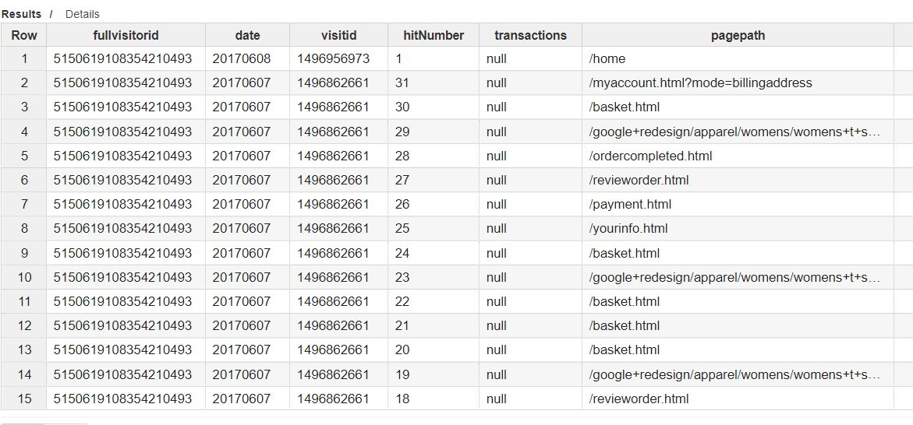
Error Analysis
False Positive
Query and look at hits level data
 | fullvisitorid | date | proba | transaction
1 | 6.23809E+18 | 6/14/2017 | 0.965155 | 0
2 | 5.15062E+18 | 6/7/2017 | 0.957586 | 0
3 | 9.14215E+17 | 6/15/2017 | 0.952014 | 0
4 | 7.31124E+18 | 6/26/2017 | 0.951928 | 0
5 | 9.32835E+18 | 6/1/2017 | 0.951882 | 0
6 | 4.51631E+18 | 6/7/2017 | 0.951588 | 0
7 | 4.9456E+18 | 6/30/2017 | 0.95133 | 0
8 | 9.09102E+18 | 6/23/2017 | 0.947925 | 0
9 | 1.66105E+18 | 6/29/2017 | 0.947576 | 0
# | 6.55601E+18 | 6/6/2017 | 0.946455 | 0
# | 6.73178E+18 | 6/16/2017 | 0.946358 | 0
# | 7.17987E+18 | 6/14/2017 | 0.94582 | 0
# | 6.42367E+18 | 6/27/2017 | 0.945785 | 0
# | 2.94264E+18 | 6/29/2017 | 0.944207 | 0
# | 5.15992E+17 | 6/1/2017 | 0.942765 | 0
# | 5.10551E+18 | 6/3/2017 | 0.941714 | 0
# | 4.83574E+18 | 6/28/2017 | 0.935568 | 0
# | 2.95928E+18 | 6/12/2017 | 0.934867 | 0
# | 6.25303E+18 | 6/23/2017 | 0.934119 | 0
>
Session ended at checkout page >
Visitor probably having second thought at the cost?
Notes:
And going deeper into individual visitor level, we can sort all visitors with a high likelihood of purchase from the model and to find those visitors who did not make a transaction, and from there, go deeper into the session into the hits level to find out exactly why each visitor did not make a purchase even though the model predict that they will purchase. From this individual hits data, we can see that his session ended after he visits the basket page a view times, the payment page, to review his order, and when he is suppose to key in his billing address, he ended the session.

Slide 30
Error Analysis
Looking at the hits level data from top 10 False Positive
5 visitors - Session ended at check-out page
2 visitors - Made a purchase > 7 days later
1 visitor - Session ended at sign-in page
2 visitor - Did not visit cart page
High intention to purchase
Notes:
We digged into the hits level data of the top 10 false positive in order to understand why these visitors did not purchase. Of which, 5 visitors session ended at the check out page, 2 visitors made the purchase > 7 days later, 2 visitor did not visit the cart page and 1 visitor session ended at the sign-in page. This shows that the model is rather reliable, when when these visitors did not make a purchase, 8/10 of them exhibited high intention o purchase
With this information, business can test out different strategies to these group of customers. For example, for visitors whose session ended at check-out page, business can hypothesis that maybe, these visitors are having second thoughts on the price of the purchase. Hence, what business can do is to send these group of visitors targeted promo codes in order to entice the visitor to finish the transaction.

Slide 31
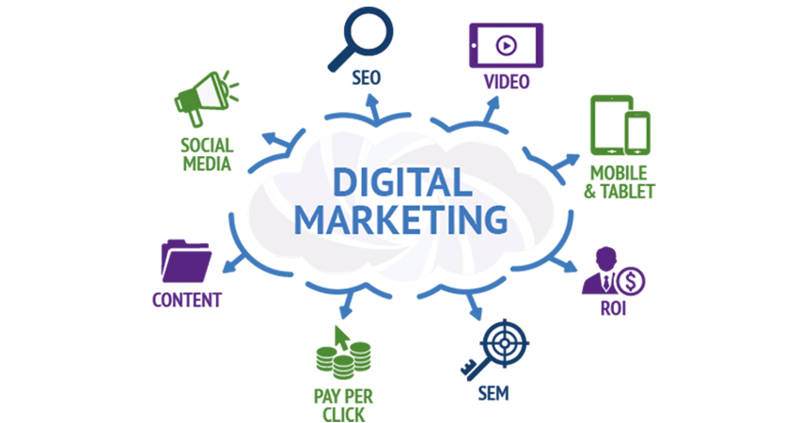

How can business use this model?
Actionable data at customer level
Specific marketing action for each individual
Targeting for Digital Marketing
Only 6.3% of visitors have > 10% likelihood to purchase
Notes:
So, finally, how can business use this model?
First of all, business can use this model for targeting for digital marketing. Instead of sending ads to all visitors, the business can narrow down their target audience, say for instance, to target visitors with >10% likelihood to purchase, they only need to reach 6.3% of all audience. THis will reduce marketing spend dramatically.
Secondly, by combining likelihood to purchase and the customer journey, business can set certain marketing triggers to improve conversion at each customer level. For instance, if the business notice that a customer with high likelihood to purchase drop out at the cart page, the business can send a $5 coupon to the visitor.

Slide 32
Q&A
Notes:
That concludes our presentation~

